Slide 1
Wine Quality Classification
mai ha lan
nguyen van duc

Slide 2
Outlines
Problem description
Classification approach
Result
Demo

Slide 3
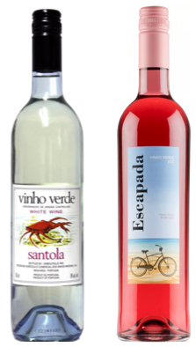
Problem description
Summary | Data In/Out | Characteristics | Collecting method
What is available? Portuguese "Vinho Verde" wine quality data 2 dataset related to Red & White wine Sample size: Red: 1599 White: 4898 What to do? Build a classification algorithm to predict the output quality (0-10) based on input characteristic data. | Input | 1 - fixed acidity 2 - volatile acidity 3 - citric acid 4 - residual sugar 5 - chlorides 6 - free sulfur dioxide 7 - total sulfur dioxide 8 - density 9 - pH 10 - sulphates 11 - alcohol | Objective tests
 | Output | Quality (score between 0 and 10) | Sensory data evaluated by wine experts

Slide 4
Backup

Slide 5
Attribute description
1 - fixed acidity: most acids involved with wine or fixed or nonvolatile (do not evaporate readily)
2 - volatile acidity: the amount of acetic acid in wine, which at too high of levels can lead to an unpleasant, vinegar taste
3 - citric acid: found in small quantities, citric acid can add ‘freshness’ and flavor to wines
4 - residual sugar: the amount of sugar remaining after fermentation stops, it’s rare to find wines with less than 1 gram/liter and wines with greater than 45 grams/liter are considered sweet
5 - chlorides: the amount of salt in the wine
6 - free sulfur dioxide: the free form of SO2 exists in equilibrium between molecular SO2 (as a dissolved gas) and bisulfite ion; it prevents microbial growth and the oxidation of wine
7 - total sulfur dioxide: amount of free and bound forms of S02; in low concentrations, SO2 is mostly undetectable in wine, but at free SO2 concentrations over 50 ppm, SO2 becomes evident in the nose and taste of wine
8 - density: the density of water is close to that of water depending on the percent alcohol and sugar content
9 - pH: describes how acidic or basic a wine is on a scale from 0 (very acidic) to 14 (very basic); most wines are between 3-4 on the pH scale
10 - sulphates: a wine additive which can contribute to sulfur dioxide gas (S02) levels, wich acts as an antimicrobial and antioxidant
11 - alcohol: the percent alcohol content of the wine
Output variable (based on sensory data): 12 - quality (score between 0 and 10)
Source: https://rpubs.com/Daria/57835

